Slide 1
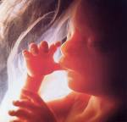
The Beginning of the Life Cycle
Mrs. Scott

Slide 2
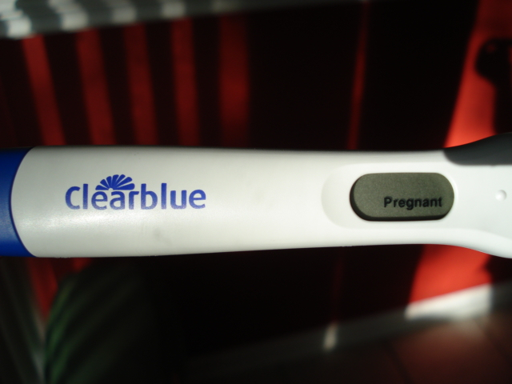
Early Pregnancy Signs
Late period
Nausea/Vomiting
Acne
Sore/swollen breasts
Tiredness
Positive read on an over the counter pregnancy test.

Slide 3
Important! Important! Important!
It is very important to see a doctor as soon as you find out you are pregnant. (usually at 8 weeks)
Prenatal Vitamins
Diet (500 extra cal/day from good food sources) and those to avoid (caffeine, certain fish, meats, cheeses, eggs)
Exercise
What medicines can be taken (obviously ALL recreational drugs are a NO including tobacco, alcohol and of course marijuana!). You should care more about your child. Many prescription medications should not be taken as well.
Answer Questions
He or she will also teach you to how to recognize the signs of possible problems during pregnancy (called complications). This is especially important because teens are more at risk for certain complications such as anemia, high blood pressure, miscarriage, and delivering a baby earlier than usual (called premature delivery).
At first you’ll go once a month, then later on it’s once every couple weeks, then once a week.

Slide 4
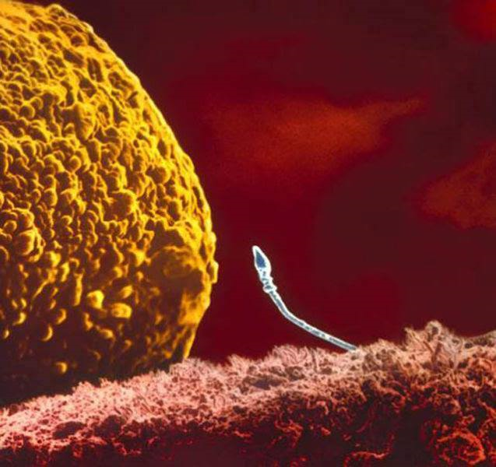
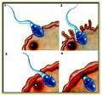
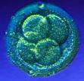
Phase 1
Conception begins with the union of the female and male sex cells (egg and sperm) this is called Fertilization and happens in the fallopian tube.
The fertilized egg at this point is called a Zygote. (1-3 wks)

Slide 5
Phase 2
The zygote then keeps traveling down the fallopian tube.
During this time the zygote has divided itself many times to create a cluster of cells with a hollow space in the center.
Within a few days the zygote attaches itself to a spot on the wall of the uterus, this is called implantation.

Slide 6
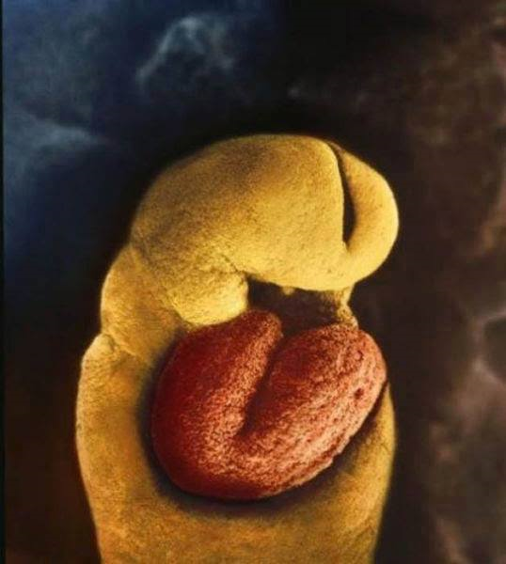
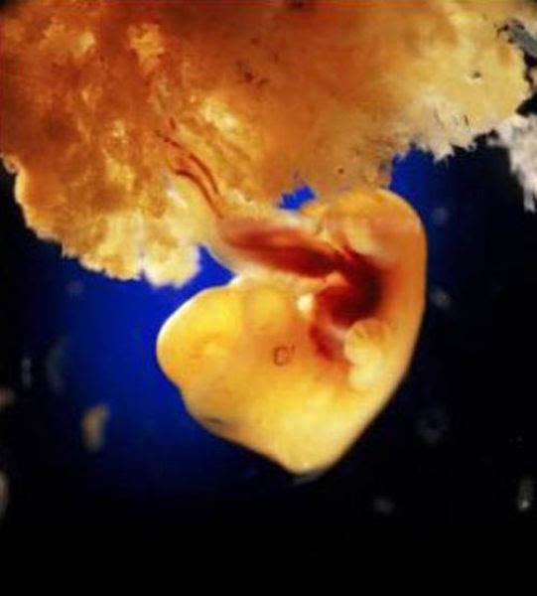
Phase 3
As the embryo grows the cells continue to divide, forming three tissue layers, later on these will become the different body systems.
One layer- respiratory and digestive
Second- muscles, blood vessels, bones, and skin
Third- nervous system, sense organs, and mouth
During this time the amniotic sac and umbilical cord form outside the embryo.
Brain
Heart
(heartbeat starts after the 18th day)
40 days

Slide 7
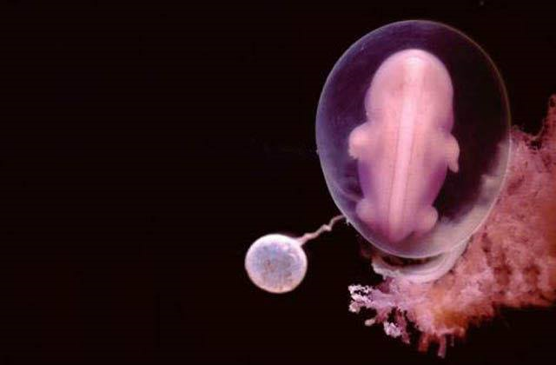
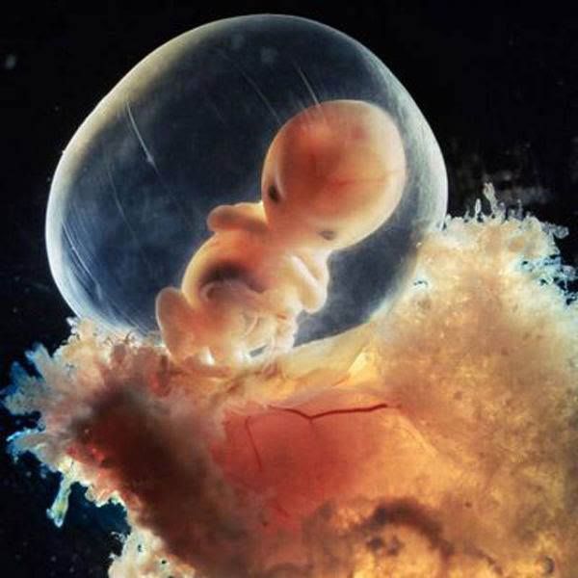
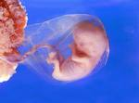
The Zygote, Embryo and Fetus
That cluster of cells keeps dividing, by the third and eighth weeks of pregnancy it is called an embryo.
After the 8th week it is now called a fetus until it’s born.

Slide 8
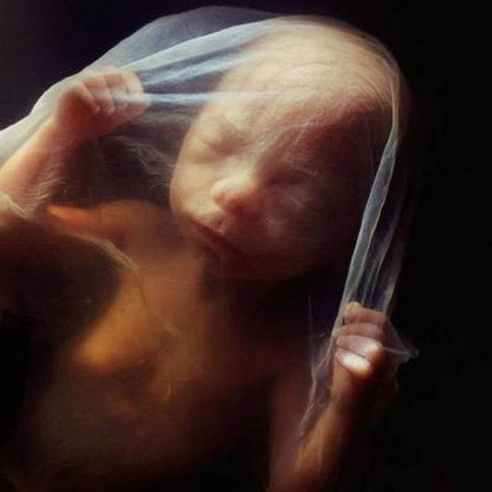
What do they do?
Amniotic sac- fluid filled sac surrounding the embryo, it protects and helps insulate.
Umbilical Cord- ropelike structure that connects the embryo to the mother through the placenta, it brings oxygen and nutrients to the embryo and takes waste away from the embryo.
The placenta is the structure that is made of thick, blood rich tissue, this nourishes the embryo
18 weeks

Slide 9
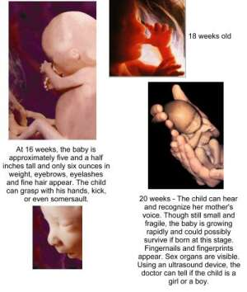
The Last Stages
From conception to labor, pregnancy usually lasts 9 months.

Slide 10
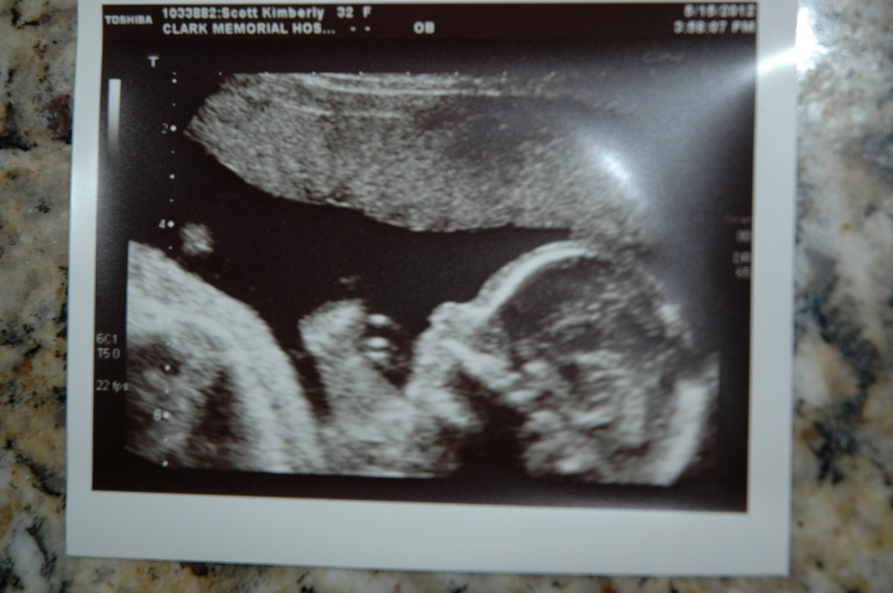
Ultrasound Pics Week 20

Slide 11
Where does pregnancy weight gain go?
Let's say your baby weighs in at 7 or 8 pounds. That accounts for some of your pregnancy weight gain. But what about the rest?
Here's a sample breakdown:
Baby: 7 to 8 pounds
Larger breasts: 1 to 3 pounds
Larger uterus: 2 pounds
Placenta: 1 1/2 pounds
Amniotic fluid: 2 pounds
Increased blood volume: 3 to 4 pounds
Increased fluid volume: 3 to 4 pounds
Fat stores: 6 to 8 pounds
Normal Amount of Weight to Gain: 25-35 lbs.

Slide 12
Pregnancy Pics…The Belly Just Keeps Growing….Until
39 weeks (1 week before delivery) with Addy
36 Weeks (1 week before delivery) with Emmy

Slide 13
LABOR!
Labor is when the uterine walls start to contract to push the baby out.
3 stages of Labor
Dilation of the cervix (10 cm), usually the baby’s head is resting on the cervix, when contractions start it can cause the woman’s water to break- this is the amniotic sac breaking and the start of labor.
Passage through the birth canal.
Afterbirth- placenta is passed through the birth canal and the umbilical cord is cut.
http://www.babycenter.com/fetal-development-images-38-weeks

Slide 14
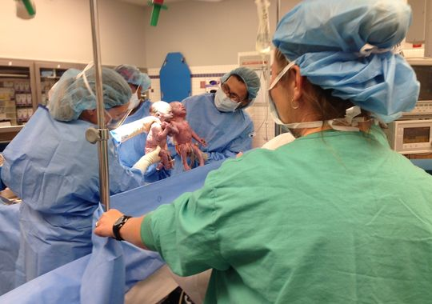
These monoamniotic twins (shared same amniotic sac and in constant contact with each other-pretty rare) were even holding hands when they were born.

Slide 15
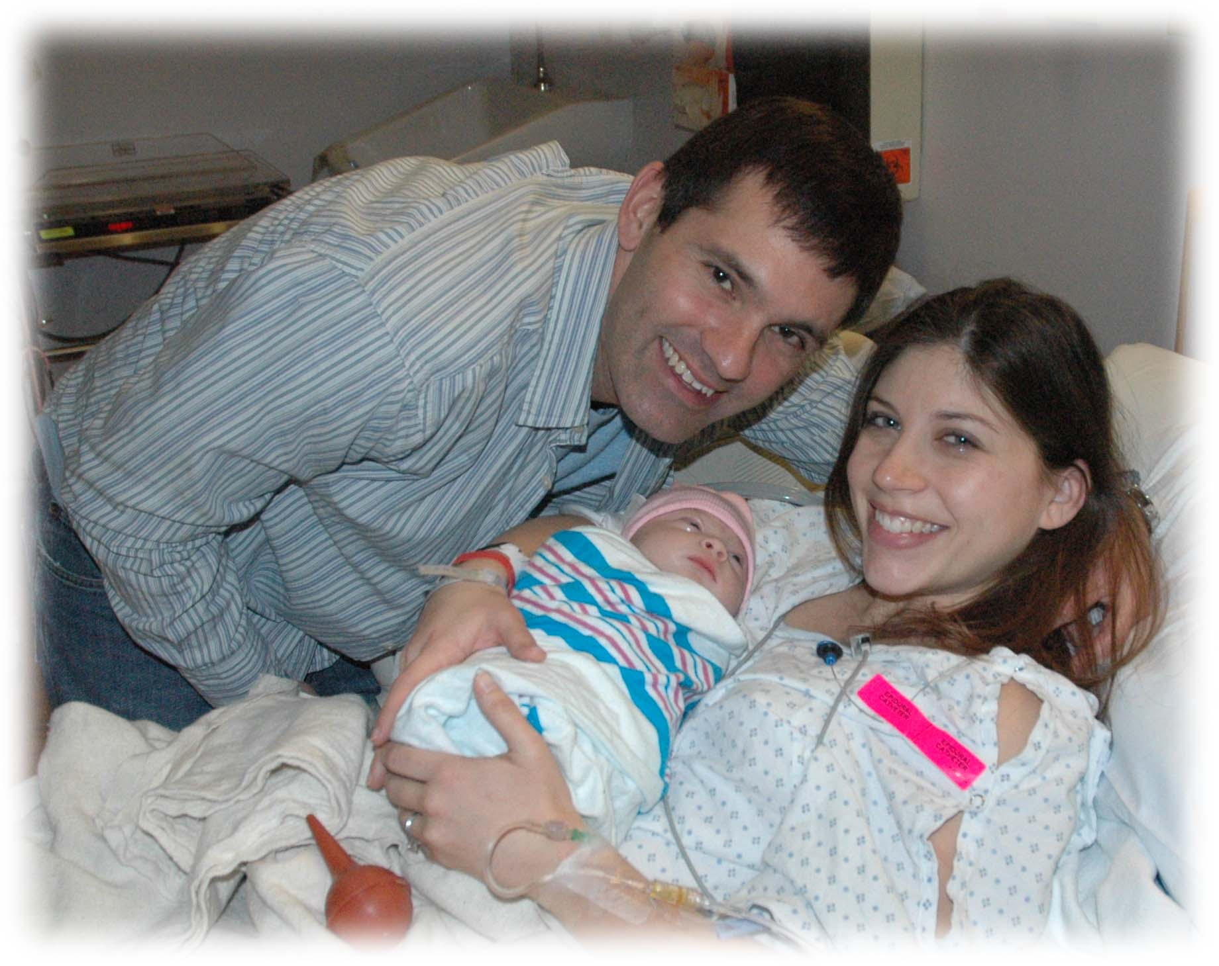
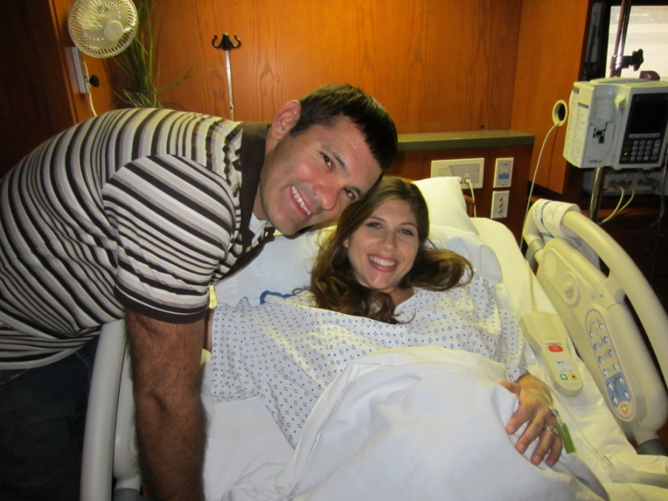
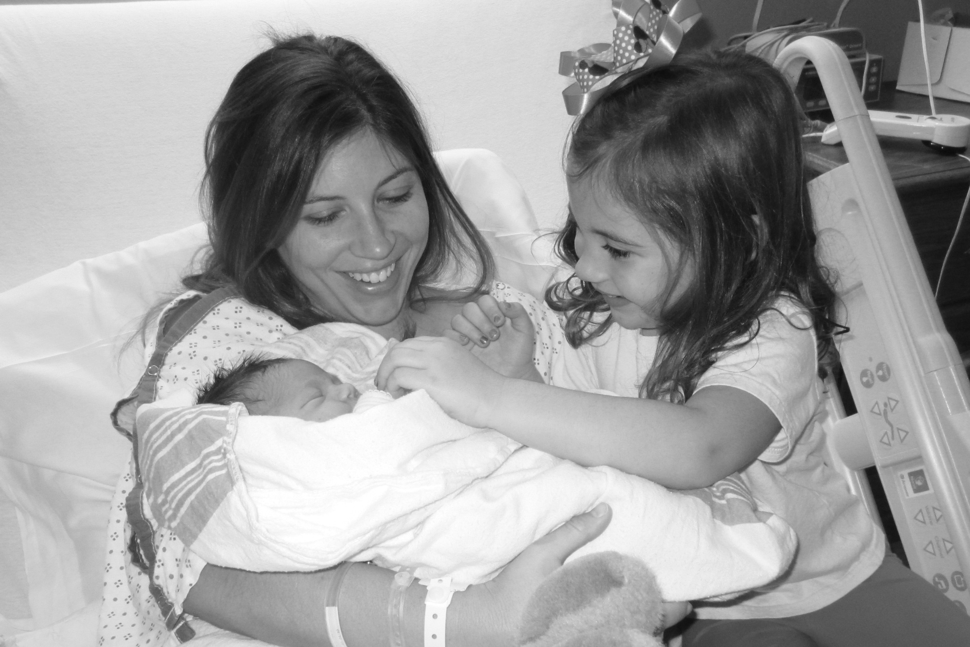
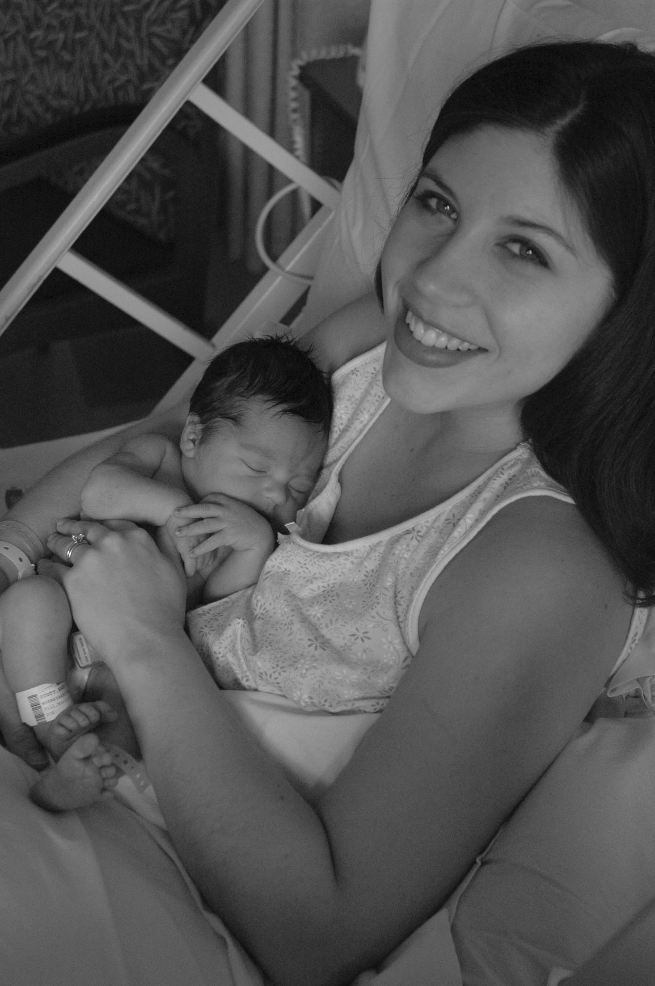
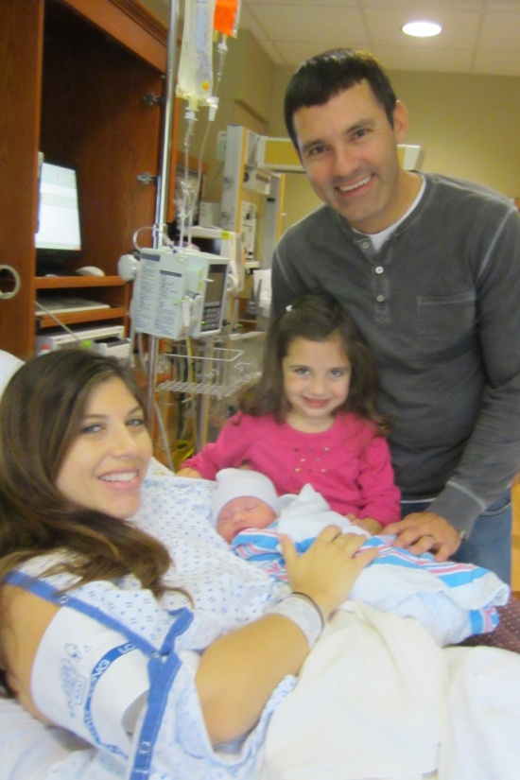
Delivery Day
12-29-07
Emmy Grace-Marie Scott
Addy Hope Scott
9-29-12

Slide 16
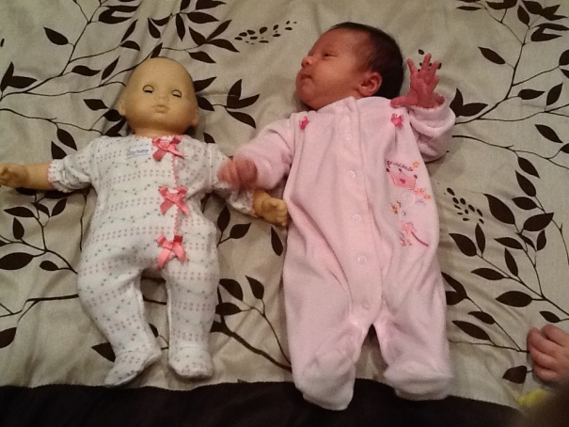
And After…I LOVE My Family

Slide 17
Keep in Mind (these are the stats):
Having a baby is a life changing experience. It will be the hardest job you’ll ever do. You will want to wait until you are mentally and financially capable of caring for and providing for a child.
Statistics about teen parents:
Teen pregnancy costs the United States at least $7 billion annually.
Every year around 750,000 teenagers will get pregnant.
Unmarried teenagers having children account for 24 percent of all unmarried expectant mothers.
More than 2/3 of all teenagers who have a baby will not graduate from high school, hence the correlation with teenage pregnancy and education.
Billions of dollars are spent taking care of teenage mothers and their children and they are more likely to be in the poverty bracket.

Slide 18
Statistics about Teen Mothers:
The younger a teenaged girl is when she has sex for the first time, the more likely she is to have had unwanted or non-voluntary sex. Close to four in ten girls who had first intercourse at 13 or 14 report it was either non-voluntary or unwanted.
Teen mothers are less likely to complete high school (only one-third receive a high school diploma) and only 1.5% have a college degree by age 30. Teen mothers are more likely to end up on welfare (nearly 80 percent of unmarried teen mothers end up on welfare).
¾ teen girls who have intercourse do so because their boyfriends wanted them to.
Teens who choose not to have sex tend to have strong emotional relationships with their parents.
Girls who choose not to have sex typically give the following good reasons:
Goes against religious and moral beliefs.
They haven’t met the 100% right person (they have high standards, which is good).
They don’t want to become pregnant and /or get an STD.

Slide 19
Statistics about the Children of Teen Parents:
Have a higher percentage of lower birth weights because the moms are fearful of gaining weight, are not going to the dr. and are not eating proper foods.
They are more likely to perform poorly in school, display aggressive behavior and are at greater risk of abuse and neglect.
The sons of teen mothers are 13 percent more likely to end up in prison.
The daughters of teens are 22 percent more likely to become teen mothers themselves, economically dependent, and less likely to escape poverty.
They are more likely to grow up in single parent households in low income housing, and drop out of high school.
Children born to teen mothers often do not have an even start in life. They are more likely to grow up in a poor and mother-only family, to live in a poor or underclass neighborhood, they aren’t prepared for school when they start (academically) and experience high risks to both their health status and potential school achievement.

Slide 20
Things to think about as a 9th grader:
-Who would watch my baby when I’m at school?
-How will I pay for child care, diapers, wipes, food, formula, clothing, medical expenses, toiletries, etc.
-What will I do when my baby gets sick, I can’t drive?
-If I don’t finish high school, how will I be able to financially support myself and my child?
-Where will my child and I live? (Most of you probably don’t want to live at home with their parents now, let alone forever)
-What if there is something really medically wrong with my child, can I handle that?
-Most teen couples who become pregnant do not stay together.
Think about 3 things that you could no longer do if you found out that you were going to be a mom or a dad today. Is sex really worth giving that up?? People respect you more if you don’t have sex than if you do.

Slide 21
Words of advice:
You want to be with the right person and 100% excited when you find out that you’re/your wife is pregnant, not panicking. What’s really the negative in waiting? If you think about it, there are way more pros to waiting than there are pros to not waiting.
So, finish high school, go to college, get married, then have children. You’ll be more prepared, you won’t have to parent on your own, you’ll be more knowledgeable, you’ll be able to provide good medical/child care, and you’ll be financially stable. You want the best possible life for your child, waiting will ensure this of happening. You want to be able to provide for your child, not relying on others to do it for you. Sex can wait until you’re 110% ready for everything that might come with it.
~Mrs. Scott

